Slide 1
Chapter 9: Virtual Memory
Background
Page Replacement
Allocation of Frames
Thrashing
Operating System Examples

Slide 2
Background
Virtual memory – separation of user logical memory from physical memory.
  Only part of the program needs to be in memory for execution.
  Logical address space can therefore be much larger than physical address space.
  Allows address spaces to be shared by several processes.
  Allows for more efficient process creation.
Virtual memory can be implemented via:
  Demand paging
  Demand segmentation

Slide 3

Steps in Handling a Page Fault

Slide 4
What happens if there is no free frame?
Page replacement – find some page in memory, but not really in use, swap it out.
  algorithm
  performance – want an algorithm which will result in minimum number of page faults.
Same page may be brought into memory several times.

Slide 5
Page Replacement
Find the location of the desired page on disk.
Find a free frame:
- If there is a free frame, use it.
- If there is no free frame, use a page replacement algorithm to select a victim frame.
    - Write the victim page to the disk, change the page and frame tables accordingly.
Read the desired page into the (newly) free frame. Update the page and frame tables.
Restart the process.

Slide 6

Page Replacement

Slide 7
Page Replacement Algorithms
Want lowest page-fault rate.
Evaluate algorithm by running it on a particular string of memory references (reference string) and computing the number of page faults on that string.
referece string (page size is 100)
  0100, 0432, 0101, 0612, 0102, 0103, 0104, 0101, 0611, 0102
  1,4,1,6,1,6,1

Slide 8

Graph of Page Faults Versus The Number of Frames
for reference string: 7, 0, 1, 2, 0, 3, 0, 4, 2, 3, 0, 3, 2

Slide 9
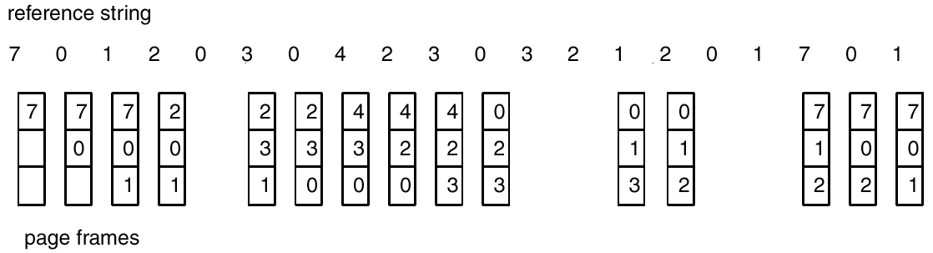
FIFO Page Replacement

Slide 10
First-In-First-Out (FIFO) Algorithm
Reference string: 1, 2, 3, 4, 1, 2, 5, 1, 2, 3, 4, 5
3 frames (3 pages can be in memory at a time per process)
4 frames
FIFO Replacement – Belady’s Anomaly
  more frames ⇒ less page faults
1
1
4
5
2
2
1
3
9 page faults
3
3
2
4
1
1
5
4
2
2
1
5
10 page faults
3
3
2
4
4
3

Slide 11

FIFO Illustrating Belady’s Anamoly

Slide 12
Optimal Algorithm
Replace page that will not be used for longest period of time.
4 frames example
1, 2, 3, 4, 1, 2, 5, 1, 2, 3, 4, 5
How do you know this?
Used for measuring how well your algorithm performs.
1
4
2
6 page faults
3
4
5

Slide 13
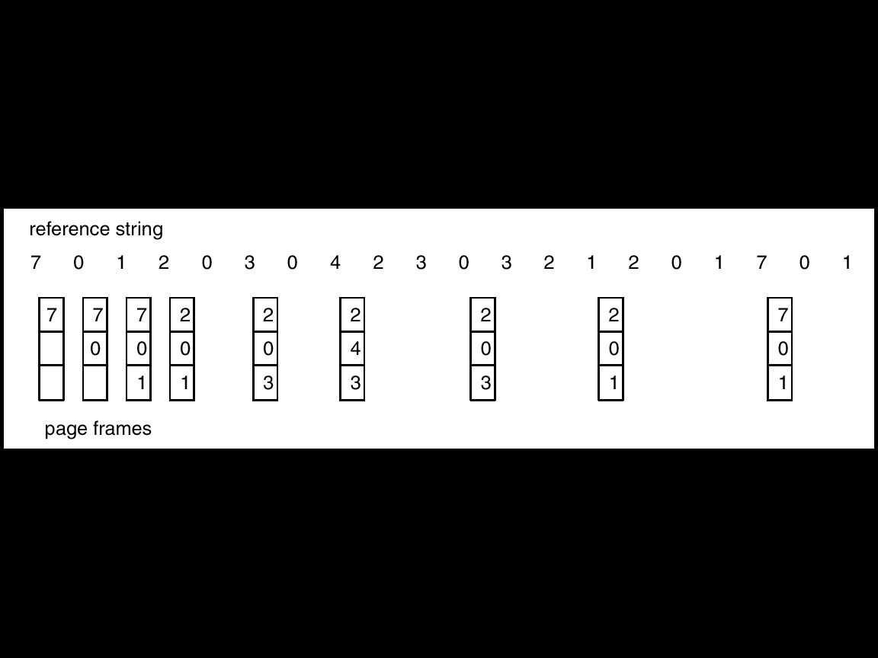
Optimal Page Replacement

Slide 14
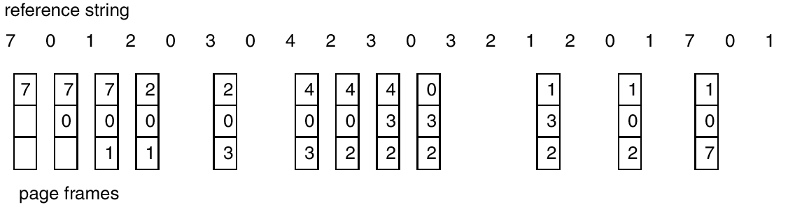
Least Recently Used (LRU) Algorithm
Reference string: 1, 2, 3, 4, 1, 2, 5, 1, 2, 3, 4, 5
1
5
2
3
5
4
4
3

Slide 15
LRU Algorithm (Cont.)
Counters: time of last reference
  Every page entry has a counter; every time page is referenced through this entry, copy the clock into the counter.
  When a page needs to be changed, look at the counters to determine which are to change.
Stack implementation – keep a stack of page numbers in a double link form:
  Page referenced:
    move it to the top
    requires 6 pointers to be changed at worst case
  No search for replacement

Slide 16
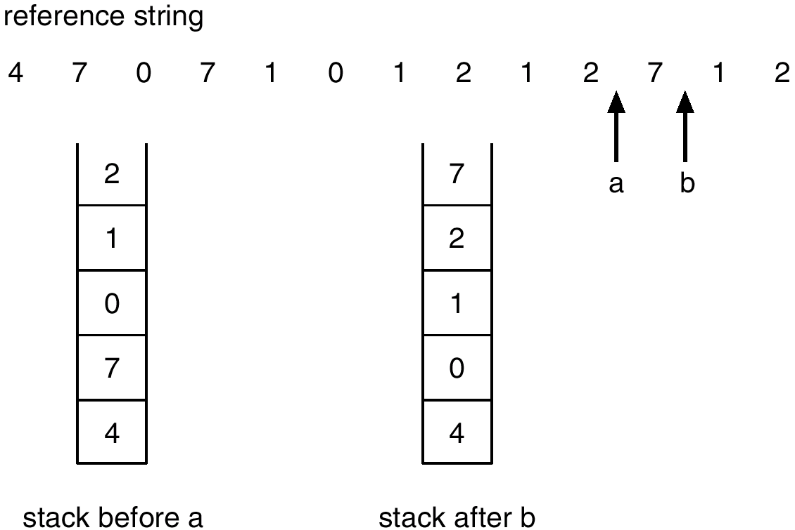
Use Of A Stack to Record The Most Recent Page References

Slide 17
LRU Approximation Algorithms
Reference bit
  With each page associate a bit, initially = 0
  When page is referenced, bit set to 1.
  Replace the one which is 0 (if one exists). We do not know the order, however.
additional reference bits
  10000000 01000000
Second chance
  Need reference bit.
  Clock replacement.
  If page to be replaced (in clock order) has reference bit = 1. then:
    set reference bit 0.
    leave page in memory.
    replace next page (in clock order), subject to same rules.

Slide 18

Second-Chance (clock) Page-Replacement Algorithm

Slide 19
Enhanced algorithm: (ref, mod)
  (ref, mdfy)
  (0, 0)
  (0, 1)
  (1, 0)
  (1, 1)

Slide 20
Counting Algorithms
Keep a counter of the number of references that have been made to each page.
LFU Algorithm: replaces page with smallest count.
MFU Algorithm: based on the argument that the page with the smallest count was probably just brought in and has yet to be used.

Slide 21
Page buffering algorithm
Page buffer: A free frame pool
  Select a victim
  Load the page to another of the frame pool, without swap out
  modified page is written to disk, when paging device is idle
reuse the frame in the pool
  keep the page number to the frame

Slide 22
Allocation of Frames
Each process needs minimum number of pages.
Example: IBM 370 – 6 pages to handle SS MOVE instruction:
  instruction is 6 bytes, might span 2 pages.
  2 pages to handle from.
  2 pages to handle to.
Two major allocation schemes.
  fixed allocation
  priority allocation

Slide 23


Fixed Allocation
Equal allocation – e.g., if 100 frames and 5 processes, give each 20 pages.
Proportional allocation – Allocate according to the size of process.

Slide 24
Priority Allocation
Use a proportional allocation scheme using priorities rather than size.
If process P_{i} generates a page fault,
  select for replacement one of its frames.
  select for replacement a frame from a process with lower priority number.

Slide 25
Global vs. Local Allocation
Global replacement – process selects a replacement frame from the set of all frames; one process can take a frame from another.
  one process can not control its own page-fault rate.(take 0.5 second for one execution, and 10.3 fro another one)
Local replacement – each process selects from only its own set of allocated frames.

Slide 26
Thrashing
If a process does not have “enough” pages, the page-fault rate is very high. This leads to:
  low CPU utilization.
  operating system thinks that it needs to increase the degree of multiprogramming.
  another process added to the system.
Thrashing ≡ a process is busy swapping pages in and out.

Slide 27

Thrashing
Why does demanded paging work?
Locality model
  Process migrates from one locality to another.
  Localities may overlap.
Why does thrashing occur?
Σ size of locality > total memory size

Slide 28

Locality In A Memory-Reference Pattern

Slide 29
Working-Set Model
Δ ≡ working-set window ≡ a fixed number of page references
Example: 10,000 instruction
WSS_{i} (working set of Process P_{i}) =
total number of pages referenced in the most recent Δ (varies in time)
  if Δ too small will not encompass entire locality.
  if Δ too large will encompass several localities.
  if Δ = ∞ ⇒ will encompass entire executing modules.
D = Σ WSS_{i} ≡ total demand frames
if D > m ⇒ Thrashing
Policy if D > m, then suspend one of the processes.

Slide 30

Working-set model

Slide 31
Keeping Track of the Working Set
Approximate with interval timer + a reference bit
Example: Δ = 10,000
  Timer interrupts after every 5,000 time units.
  Keep in memory 2 bits for each page.
  Whenever a timer interrupts copy refence and sets the values of all reference bits to 0.
  If one of the bits in memory = 1 ⇒ page in working set.
Why is this not completely accurate?
Improvement = 10 bits and interrupt every 1000 time units.

Slide 32

Page-Fault Frequency Scheme
Establish “acceptable” page-fault rate.
  If actual rate too low, process loses frame.
  If actual rate too high, process gains frame.
  upper and lower bounds of rate

Slide 33
Other Considerations
Prepaging
  prevent the high level page fault
  bring into memory all the pages that will be needed
Page size selection
  fragmentation
  table size
  I/O overhead
  locality
  total I/O
  I/O 次数 vs I/O quantity vs I/O time

Slide 34
Other Considerations (Cont.)
TLB Reach - The amount of memory accessible from the TLB.
TLB Reach = (TLB Size) X (Page Size)
Ideally, the working set of each process is stored in the TLB.

Slide 35
Increasing the Size of the TLB
Increase the Page Size. This may lead to an increase in fragmentation as not all applications require a large page size.
Provide Multiple Page Sizes. This allows applications that require larger page sizes the opportunity to use them without an increase in fragmentation.

Slide 36
Other Considerations (Cont.)
Program structure
  int A[ ][ ] = new int[1024][1024];
  Each row is stored in one page
  Program 1 for (j = 0; j < A.length; j++)
  for (i = 0; i < A.length; i++)
  A[i,j] = 0;
  1024 x 1024 page faults
  Program 2 for (i = 0; i < A.length; i++)
  for (j = 0; j < A.length; j++)
  A[i,j] = 0;
  1024 page faults

Slide 37
Other Considerations (Cont.)
I/O Interlock – Pages must sometimes be locked into memory.
Consider I/O. Pages that are used for copying a file from a device must be locked from being selected for eviction by a page replacement algorithm.

Slide 38
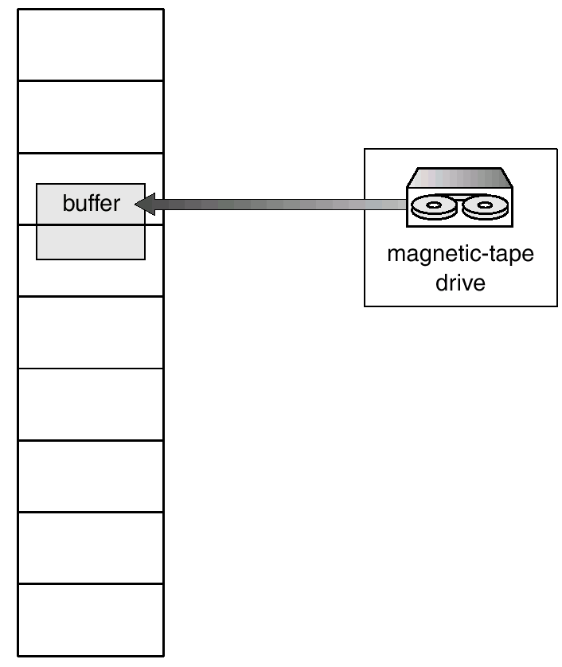
Reason Why Frames Used For I/O Must Be In Memory

Slide 39
Windows NT
Uses demand paging with clustering. Clustering brings in pages surrounding the faulting page.
Working set minimum is the minimum number of pages the process is guaranteed to have in memory.
A process may be assigned as many pages up to its working set maximum.---local page replacement.
When the amount of free memory in the system falls below a threshold, automatic working set trimming is performed to restore the amount of free memory.
Working set trimming removes pages from processes that have pages in excess of their working set minimum.

Slide 40
Solaris 2
Maintains a list of free pages to assign faulting processes.
Lotsfree – threshold parameter to begin paging.
Paging is peformed by pageout process.
Pageout scans pages using modified clock algorithm.
Scanrate is the rate at which pages are scanned(pages/second). This ranged from slowscan (100page/sec) to fastscan(8192pages/sec).
handspread---the distance between the two hands
Pageout is called more frequently depending upon the amount of free memory available.
maybe page out all the pages used by a process

Slide 41
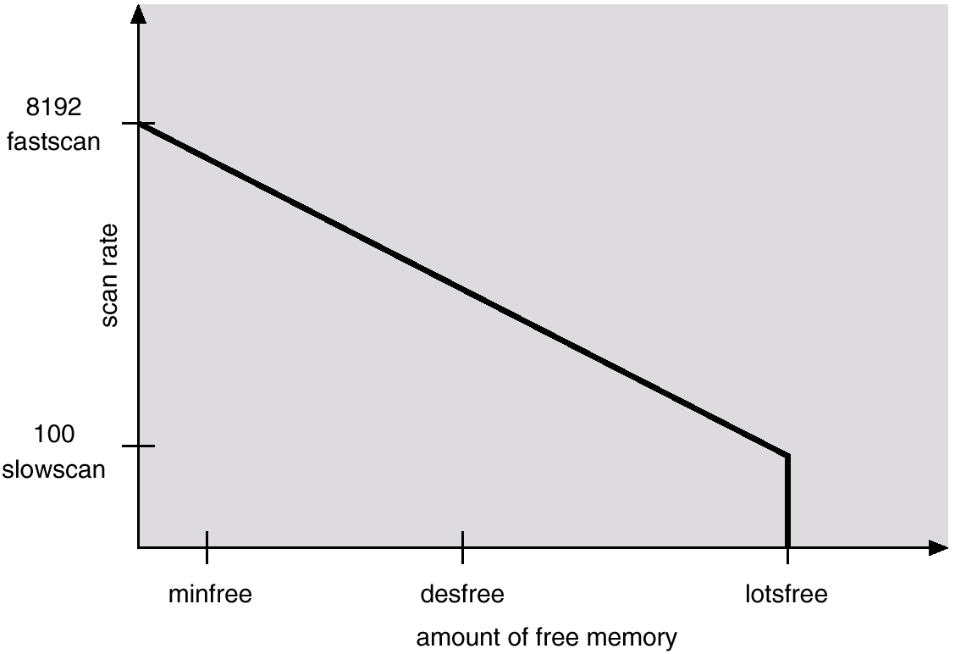
Solar Page Scanner

